Slide 1
Computer Materials Management Application
Presented by
KOLLE NTUBE DORIS
JEFFERSON CLINTON Y.
CHIA CARLSON
NKTEKEH BLAISE
Presented to:
MR KAH KISSINGER

Slide 2

WebMate+: A Unified Solution for Computer Material Management on Web and Mobile
Application for the management of services, selling and maintenance of computer material.

Slide 3
System Objectives
Objectives
Inventory Optimization
Secure and compliant operation
Supplier relationship management
Enhanced Customer service
Monitoring stock levels, Categorizing products, Receiving low stock notifications
Provide a superior customer experience through effective management of customer interactions, service requests and sales transactions
Implement robust security measures to protect sensitive data, Adhere to data protection laws, Ensure compliance with industry regulations
Effectively manage relationship with suppliers, track orders, and evaluate supplier performance for a reliable and efficient supply chain.

Slide 4
Functional Requirements
Administrator
CRUD on administrative users
Customers
View products
Rate product and delivery quality
CRUD products
Monitors activities
Assigns tasks, permissions and administrative roles
Purchase products
Make service Requests
View and update personal accounts

Slide 5
Functional Requirements
Service Technicians
Receives Orders
Delivery Agents
Manages service requests
Delivers products
Receives feedbacks
Submit invoices
Tracks tasks
Prioritize tasks
Communicates with customers

Slide 6
Functional Requirements
Payment Gateway
Access payment
System(Automated)
Logout users, after mins of inactivity.
Process payment
Send confirmation messages after payments have been successfully done by customers.
Backs-up and recovers data.
Send notification messages
Implement and maintain security protocols

Slide 7
Non functional Requirements
Performance: It should respond to interactions within 2secs to ensure a responsive experience
Security: User data, and financial information must be encrypted during transmission and storage
Reliability: It should have a minimum uptime of 99.9% to ensure continuous availability
Usability: It should be intuitive and user friendly, requiring minimal training for new users
Accessibility: The system should adhere to accessibility standards, such as WCAG.
Scalability : It should be able to accommodate a 50% growth in user base, and data volume over the next two years.

Slide 8
AGILE METHODOLOGY
Why Agile methodology?
Iterations
Collaborations
Adaptability
Customer feedback
Iterative refinement

Slide 9
Project plan and lifecycle
Project planning and analysis
1. Duration: 1week
*Day 1-2:Project kickoff and requirement review
*Day 3-5: Feasibility study and planning
Design and Architecture
2.Duration: 2weeks
*Day 6-10: System architecture and design
*Day 11-15: Database design and prototyping.
Development
3.Duration: 2weeks
*Day 16-20:Frontend development(Web and Mobile).
*Day 21-25:Backend development
*Integration and Testing.

Slide 10
Project plan and lifecycle
Testing and Refinement
1. Duration: 1week
*Day 31-35:System testing and bug fixing.
*Day 36-40: User acceptance testing
Deployment preparation
2.Duration: 1week
*Day 41-45: Documentation and Training.
*Day 46-50: Final testing and quality assurance.
Deployment and post-deployment
3.Duration: 1week
*Day 51-55:Deployment
*Day 21-25:Post-Deployment support.

Slide 11
Security measures
Three step authentication, password, email and OTP confirmation.
Encryption of sensitive data.
Tracking of passages delivered.
Logging out of users, after 10mins of inactivity.
System is constantly under updates to ensure maximum efficiency of the application.

Slide 12
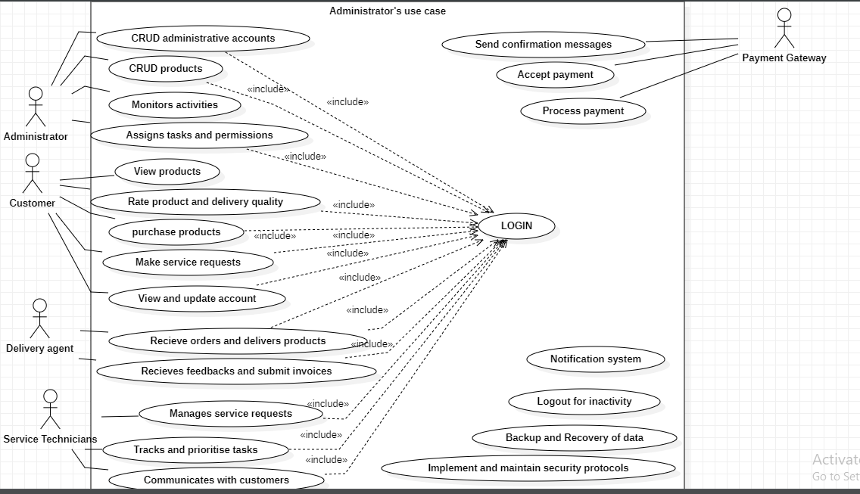
Use case diagram

Slide 13
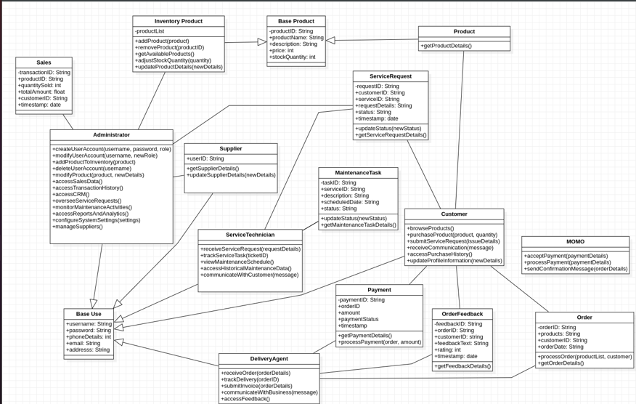
Class diagram

Slide 14
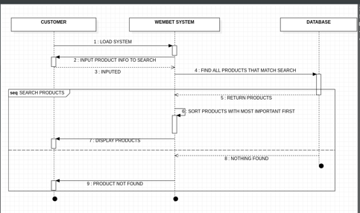
Sequence diagram
Sequence diagram to search a product.

Slide 15
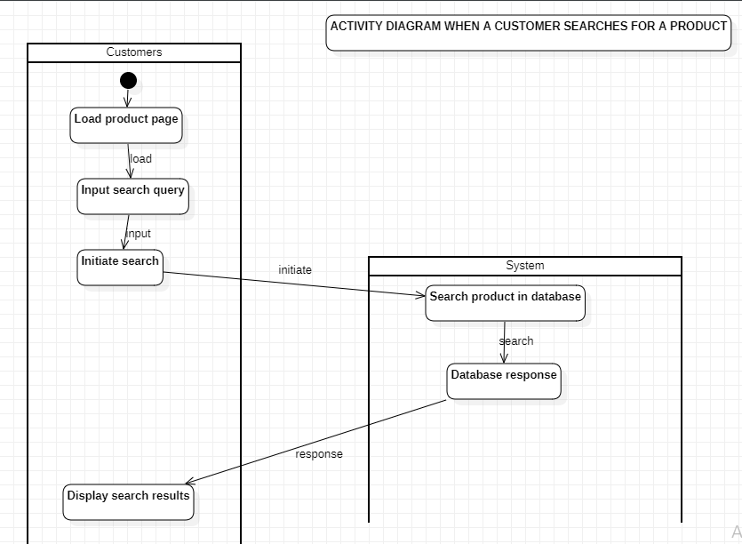
Activity diagram

